Slide 1

Monitoring Beaver induced flooding in forest lands
Final Report
Course: Data Science in Remote Sensing
Students: Lilian Akudo Akanazu
Sourav Karmakar
Mizanur Rahman
Date: 24.11.2021

Slide 2
Agenda
Overview of preliminary activities
Conclusion
& area of improvement
Final analysis
Results obtained

Slide 3
Beaver flooding; a cause for concern?
Beavers are rodents that live in water and swampy areas. They basically work as ecosystem engineers and can have a considerable large impact on a forest ecosystem
Major activity in the ecosystem is to create dams in flowing rivers to make ponds for their habitation interfering with drainage systems
By constructing dams, they cause flooding in forest areas which triggers tree damage. Most of these trees are economic trees
Besides creating dams and causing flood, tree felling is another activity that beavers cause in forested ecosystems

Slide 4
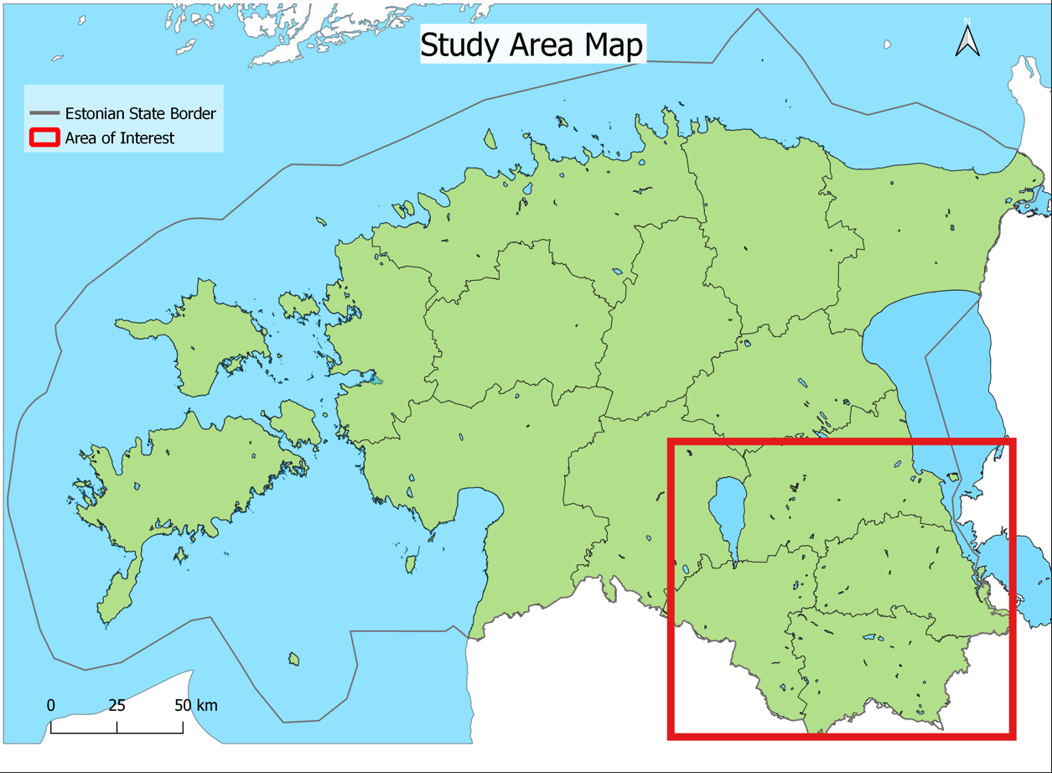

Slide 5
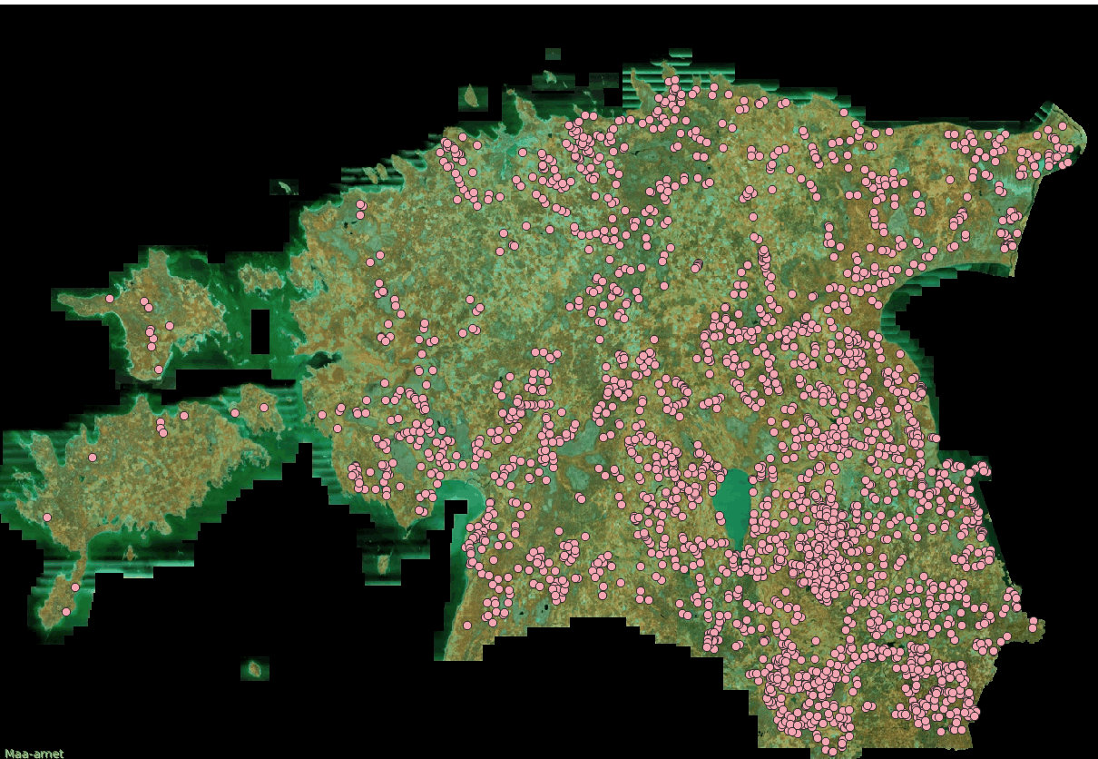
Orthophoto of Estonia with overlay of beaver point data

Slide 6
Work flow
Create a virtual raster of all bandset and indices
Calculated Indices (NDVI, NDWI, MSI) in QGIS
Resampled and select specific bands with 10m resolution in SNAP
Download Satellite Imageries (Sentinel 2)
Clip and mask polygons by virtual raster
Merge all the polygons
K means clustering
Vectorize the cluster
Dissolve the Vector
Input the polygons as ROI
Mark beaver polygons in the orthophotos
Download Orthophotos
Collect possible beaver points by hunters
Random Forest Classification
Confusion Matrix

Slide 7
Work flow
Create a virtual raster of all bandset and indices
Calculated Indices (NDVI, NDWI, MSI) in QGIS
Resampled and select specific bands with 10m resolution in SNAP
Download Satellite Imageries (Sentinel 2)
Clip and mask polygons by virtual raster
Merge all the polygons
K means clustering
Vectorize the cluster
Dissolve the Vector
Input the polygons as ROI
Mark beaver polygons in the orthophotos
Download Orthophotos
Collect possible beaver points by hunters
Random Forest Classification
Confusion Matrix

Slide 8
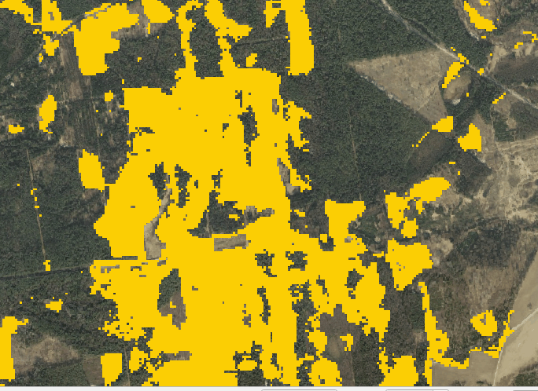
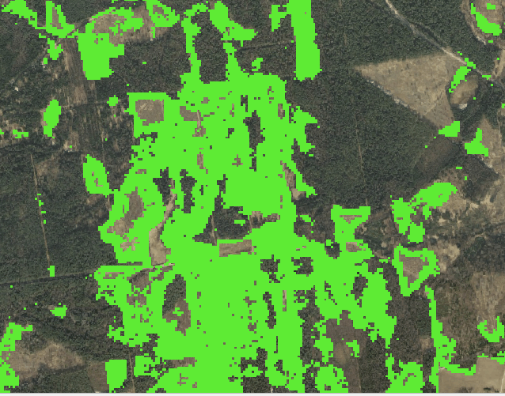
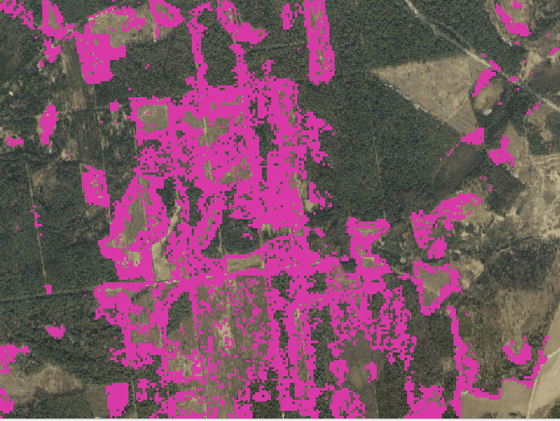
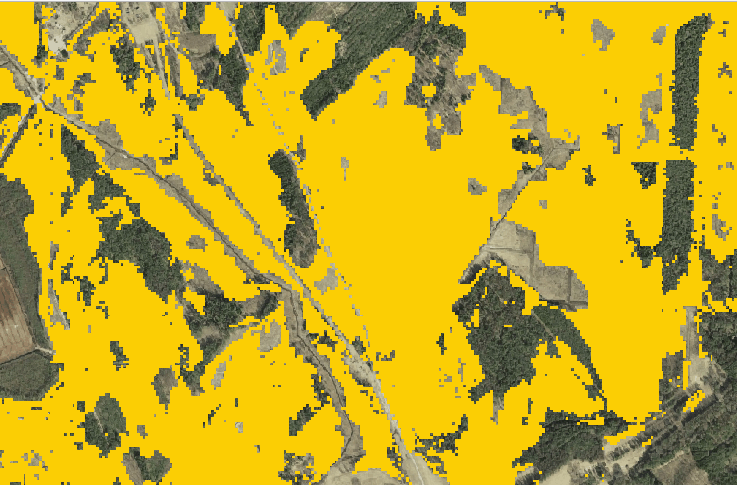
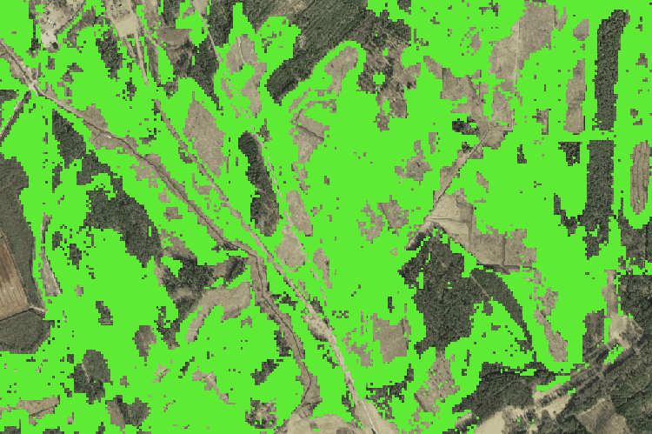
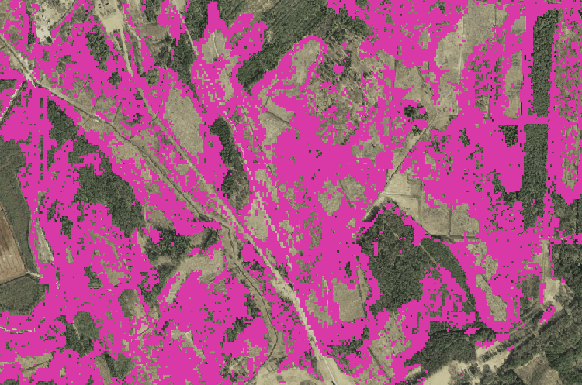

Slide 9
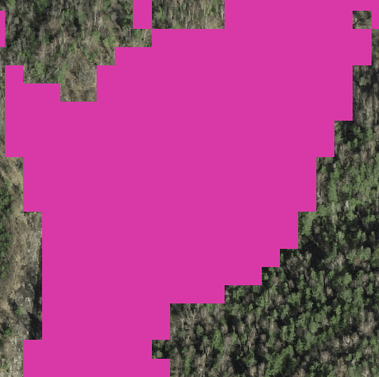
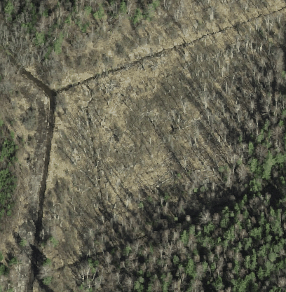
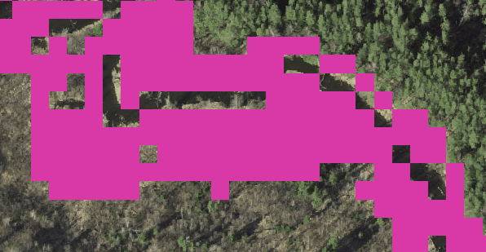
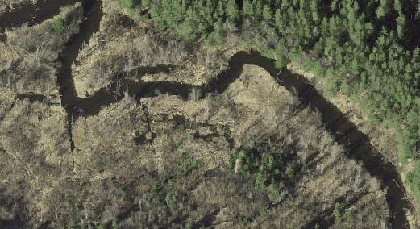

Slide 10
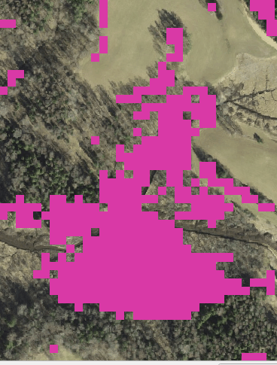
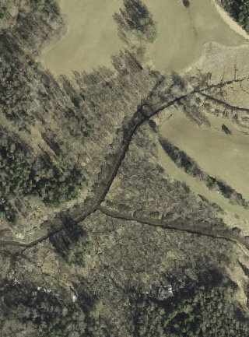
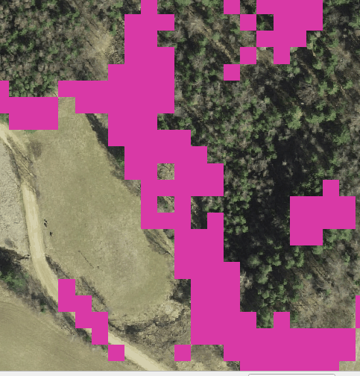
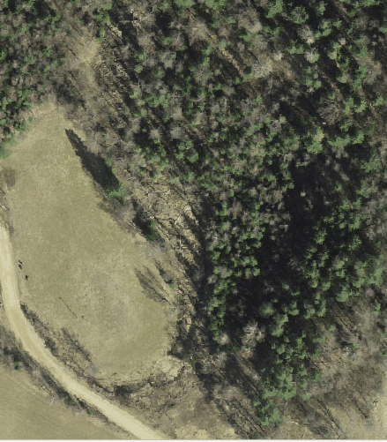
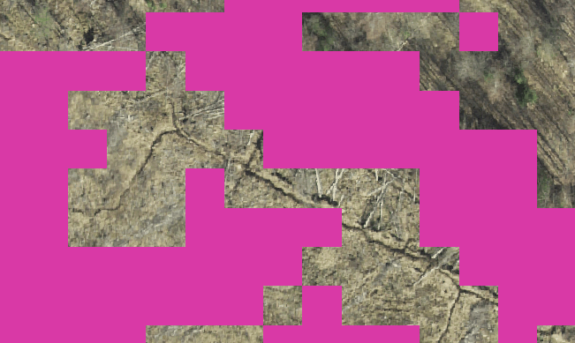
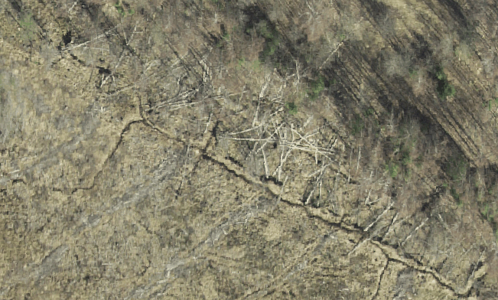

Slide 11
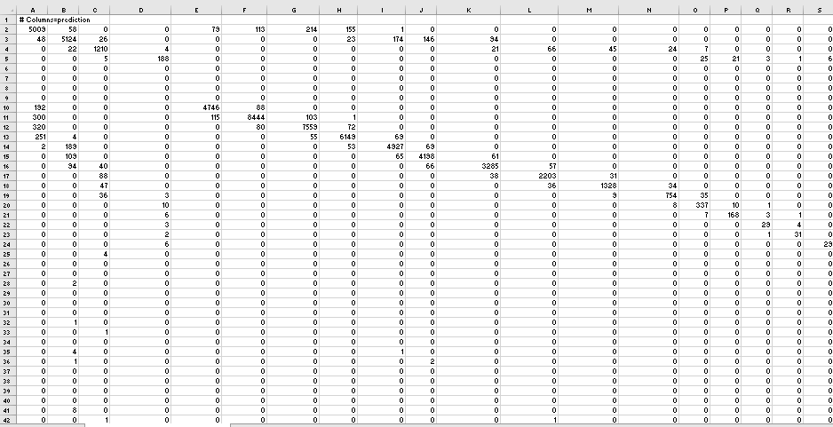
True Positive: Model predicted yes, actual yes – TP/actual yes
True Negative: Model predicted no, actual no – TN/actual no
False Positive: Model predicted yes, actual no – FP/actual no
False Negative: Model predicted no, actual yes – FN/actual yes

Slide 12
Confusion Matrix indices calculated
Accuracy: Measures the correctness of the classifier (TP/TN)total. Ranges between 0-1 with 1 being the most accurate.
Misclassification Rate: How often is the classifier wrong? Also known as “Error rate”. (FP+FN)/total Ranges from 0-1 with 1 having the most error in classification
Precision: When it predicts a yes, how often is it correct? TP/predicted yes Ranges from 0-1 with 1 being the most precise
Cohen’s Kappa: A measure of how well the classifier performed as compared to how well it would have been if it were performed by chance. A model will have a high kappa score if there is a big difference between the accuracy and null error rate.
2 x (TP x TN – FN x FP)
(TP + FP) x (FP + TN) + (TP + FN) x (FN + TN)

Slide 13
Confusion matrix 1
Confusion matrix indices
n:61993 | Predicted (Yes) | Prediction (No) | Total
Actual: Yes | 11694 | 2143 | 13837
Actual: No | 1762 | 46394 | 48156
Total | 13456 | 48537
Indices | Result
Accuracy | 0.937009017
Precision | 0.869054697
Misclassification | 0.062990983
Cohenn's Kappa | 0.816547561
Confusion matrix 2
Confusion matrix indices
n:66037 | Predicted (Yes) | Predicted (No) | Total
Actual: Yes | 11487 | 2973 | 14460
Actual: No | 1764 | 49813 | 51577
Total | 13251 | 52786
Indices | Result
Accuracy | 0.928267486
Precision | 0.866877971
Misclassification | 0.071732514
Cohen's kappa | 0.783776688
Confusion matrix 3
Confusion matrix indices
n:61567 | Predicted (Yes) | Predicted (No) | Total
Actual: Yes | 12407 | 1389 | 13796
Actual: No | 1102 | 46669 | 47771
Total | 13509 | 48058
Indices | Result
Accuracy | 0.95954
Precision | 0.918425
Misclassification | 0.04046
Cohen's kappa | 0.882781

Slide 14
Confusion matrix combined
Confusion matrix indices
n:77795 | Predicted (Yes) | Predicted (No) | Total
Actual: Yes | 8729 | 2666 | 11395
Actual: No | 4523 | 61877 | 66400
Total | 13252 | 64543
Indices | Result
Accuracy | 0.907590462
Precision | 0.658693027
Misclassification | 0.092409538
Cohen's kappa | 0.653789677
Combination of all training polygons and recalculation of random forest classification
The precision value is more realistic of the real condition of beaver compared to our previous confusion matrix
This is the first iteration with all the combined polygons, adding and subtracting more forest polygons would get it better.

Slide 15
Conclusion
Beaver activities in Estonian forests are still ongoing, however, in some locations that were marked as active beaver locations based on our orthophotos and the hunter beaver points, there are currently no beavers’ activities.
Not all the damaged forest are caused by beaver, some are also caused by anthropogenic activities.
Forested area are close to waterbody are more vulnerable to beaver activities.
The final model prediction matrix was closer to the reality of the nature of the forests with the addition of more validation samples.

Slide 16
Area of Improvement
Point location provided by hunters do not truly represent the actual beaver area, updated points would help getting better beaver damaged areas
The polygons we draw for forests, should be wider, containing all type of forests, both healthy and deforested one
Computer with good processing speed would allow more trial-and-error option, thereby improve the result
Ground-truthing would help to validate the actual beaver damaged area and thereby improve the result by adding or eliminating areas
To know the actual level of forest damage in the area, a forest loss analysis should be carried out in time series

Slide 17
References
Ken D.T., Benjamin M. J., Christopher D. A. and Ingmar N. (2018) “Tundra be dammed: Beaver colonization of the Arctic” Wiley online Library DOI: 10.1111/gcb.14332
David R.B (1989): The Failure of Beaver Dams and Resulting Outburst Flooding: A Geomorphic Hazard of the Southeastern Piedmont – The Geographical Bulletin

